Slide 1
Tuples and lists
tuples
lists
mutability
list comprehension
for-if, for-for
list()
any(), all()
enumerate(), zip()

Slide 2

Tuples
Python shell
(1, 2, 3) (1, 2, 3) () () (42) 42 (42,) (42,) 1, 2 (1, 2) 42, (42,) x = (3, 7) x (3, 7) x = 4, 6 x (4, 6) x[1] = 42 TypeError: 'tuple' object does not support item assignment
(value₀, value₁, ... , value_{k-1})
Tuples can contain a sequence of zero or more elements, enclosed by ”(” and ”)”
Tuples are immutable
Tuple of length 0: ()
Tuple of length 1: (value,)
Note the comma to make a tuple of length one distinctive from an expression in parenthesis
In many contexts a tuple with ≥ 1 elements can be written without parenthesis
Accessors to lists also apply to tuples, slices, ...
Notes:
Tuples good to prevent unexpected changes to values, opposed to lists
[42,] is also valid with a trailing comma

Slide 3
Question – What value is ((42,)) ?
42
(42)
(42,)
((42,),)
Don’t know

Slide 4
Question – What is x ?
x = [1, [2, 3], (4, 5)]
x[2][0] = 42
[1, [42, 3], (4, 5)]
[1, [2, 3], (42, 5)]
[1, [2, 3], 42]
TypeError
Don’t know

Slide 5
Question – What tree is ('A',(('B','C'),'D')) ?
/\ /\ /\ /\ /\
/ \ / \ / \ / \ / \
/ \ / \ / \ / \ / \
/ \ / \ / \ / \ / \
/\ 'D' / \ / \ / \ 'A' /\
/ \ /\ 'D' /\ /\ 'A' /\ / \
/ \ / \ / \ / \ / \ / \
/\ 'C' / \ 'A' 'B' 'C' 'D' / \ 'B' /\
/ \ 'A' /\ /\ 'D' / \
'A' 'B' / \ / \ 'C' 'D'
'B' 'C' 'B' 'C'
b) c) d) e)
f) Don’t know

Slide 6
Tuple assignment
Python shell
point = (10, 25) x, y = point x 10 y 25
Parallel assignments
x, y, z = a, b, c
is a short hand for a tuple assignment (right side is a single tuple)
(x, y, z) = (a, b, c)
First the right-hand side is evaluated completely, and then the individual values of the tuple are assigned to x, y, z left-to-right (length must be equal on both sides)

Slide 7
Nested tuple/lists assignments
Let hand side can be nested (great for unpacking data)
(x, (y, (a[0], w)), a[1]) = 1, (2, (3, 4)), 5
[...] and (...) on left side matches both lists and tuples of equal length (but likely you would like to be consistent with type of parenthesis)
Python shell
two_points = [(10, 25), (30, 40)] (x1, y1, x2, y2) = two_points ValueError: not enough values to unpack (expected 4, got 2) ((x1, y1), (x2, y2)) = two_points a = [None, None] v = ((2, (3, 4)), 5) ((y, (a[0], w)), a[1]) = v a [3, 5] [x, y, z] = (3, 5, 7) (x, y, z) = [3, 5, 7] [x, (y, z), w] = (1, [2, 3], 4) [x, (y, z), w] = (1, [2, (5, 6)], 4) z (5, 6)

Slide 8
Tuples vs lists: a += b
Python shell
(1, 2) + (3, 4) (1, 2, 3, 4) x = [1, 2] y = x y += [3, 4] y [1, 2, 3, 4] x [1, 2, 3, 4] x = (1, 2) y = x y += (3, 4) y (1, 2, 3, 4) x (1, 2)
Lists Extends existing list, i.e. same as a.extend(b)
Tuples Must create a new tuple a + b and assign to a (since tuples are immutable)

Slide 9
*variable assignment
Python shell
(a, *b, c, d) = (1, 2, 3, 4, 5, 6) b [2, 3, 4] (a, *b, c, d) = (1, 2, 3) b [] (a, *b, c, d) = (1, 2) ValueError: not enough values to unpack (expected at least 3, got 2) v = ((1,2,3),4,5,6,(7,8,9,10)) ((a, *b), *c, (d, *e)) = v b [2, 3] c [4, 5, 6] e [8, 9, 10] head, *tail = [1, 2, 3, 4] head 1 tail [2, 3, 4]
For a tuple of variable length a single *variable name on the left side will be assigned a list of the remaining elements not matched by variables preceding/following *
Example
a, *b, c = t
is equivalent to
a = t[0]
b = t[1:-1]
c = t[-1]
There can be a single * in a left-hand-side tuple (but one new * in each nested tuple)

Slide 10
Question – What is b ?
(*a,(b,),c) = ((1,2),((3,4)),((5,)),(6))
(1,2)
(3,4)
5
(5,)
(6)
Don’t know
Python shell
(*a,(b,),c) = ((1,2),((3,4)),((5,)),(6)) a [(1, 2), (3, 4)] b 5 c 6

Slide 11
* in list and tuple construction
Python shell
A = (1, 2, 3) B = ['B', 'C'] L = [A, B, 4, 5] L [(1, 2, 3), ['B', 'C'], 4, 5] len(L) 4 L = [*A, *B, 4, 5] L [1, 2, 3, 'B', 'C', 4, 5] len(L) 7 (*A, *B, 4, 5) (1, 2, 3, 'B', 'C', 4, 5)
When constructing a list or tuple you can insert zero or more elements from another list/tuple/sequence by inserting *expression
There can be an arbitrary number of * expressions in a tuple or list construction
Python shell
from timeit import timeit timeit('A + A + A + A + A + A + A + A', setup='A = [1,2,3,4,5,6,7,8,9,10]') 0.665172699955292 # repeated concatenation can be slow timeit('[*A, *A, *A, *A, *A, *A, *A, *A]', setup='A = [1,2,3,4,5,6,7,8,9,10]') 0.32599859999027103 # * notation can be faster for multiple concatenation
Notes:
A * 8 would be even faster in this case ~ 0.2 sec

Slide 12
List comprehension (cool stuff)
Example:
[x*x for x in [1, 2, 3]]
returns
[1, 4, 9]
General
[expression for variable in sequence]
returns a list, where expression is computed for each element in sequence assigned to variable
Python shell
[2*x for x in [1,2,3]] [2, 4, 6] [2*x for x in (1,2,3)] [2, 4, 6] [2*x for x in range(10,15)] [20, 22, 24, 26, 28] [2*x for x in 'abc'] ['aa', 'bb', 'cc'] [(None, None) for _ in range(2)] [(None, None), (None, None)]

Slide 13
List comprehension (it’s just syntactic sugar…)
Python shell
[x*2 for x in [1, 2, 3]] [2, 4, 6] L = [] for x in [1, 2, 3]: L.append(x*2) L [2, 4, 6]

Slide 14
List comprehension (more cool stuff)
Similarly to the left-hand-side in assignments, the variable part can be a (nested) tuple of variables for unpacking elements:
[expression for tuple of variables in sequence]
Python shell
points = [(3, 4), (2, 5), (4, 7)] [(x, y, x*y) for (x, y) in points] [(3, 4, 12), (2, 5, 10), (4, 7, 28)] [(x, y, x*y) for x, y in points] [(3, 4, 12), (2, 5, 10), (4, 7, 28)] [x, y, x*y for (x, y) in points] SyntexError: invalid syntax
parenthesis required for the constructed tuples

Slide 15
List comprehension – for-if and multiple for
List comprehensions can have nested for-loops
[expression for v₁ in s₁ for v₂ in s₂ for v₃ in s₃]
Can select a subset of the elements by adding an if-condition
[expression for v₁ in s₁ if condition]
and be combined...
Python shell
[(x, y) for x in range(1, 3) for y in range(4, 6)] [(1, 4), (1, 5), (2, 4), (2, 5)] [x for x in (1, 2) for x in (4, 5)] [4, 5, 4, 5] [x for x in range(1, 101) if x % 7 == 1 and x % 5 == 2] [22, 57, 92] [(x, y, x*y) for x in range(1, 11) if 6 <= x <= 7 for y in range(x, 11) if 6 <= y <= 7 and not x == y] [(6, 7, 42)]
Notes:
for x for x – usefull when both are ”_” and you don’t care about the variable

Slide 16
Question – What will print the same?
points = [(3,7), (4,10),(12,3), (9,11), (7,5)]
print([(x, y) for x, y in points if x < y])
print([x, y for x, y in points if x < y])
print([(x, y) for p in points if p[0] < p[1]])
print([p for p in points if p[0] < p[1]])
print([[x, y] for x, y in points if x < y])
Don’t know
Notes:
syntax-error
x and y not defined
d) list of lists instead of list of tuples

Slide 17
any, all
Python shell
any((False, True, False)) True any([False, False, False]) False any([]) False all([False, False, True]) False all((True, True, True)) True all(()) True L = (7, 42, 13) any([x == 42 for x in L]) True all([x == 42 for x in L]) False
any(L) checks if at least one element in the sequence L is true (list, tuple, ranges, sequence, strings, ...)
any([False, True, False])
all(L) checks if all elements in the sequence L are true
all([False, False, True])
any and all return True or False

Slide 18
Example – computing primes
Python shell
[x for x in range(2, 50) if all([x % f for f in range(2, x)])] [2, 3, 5, 7, 11, 13, 17, 19, 23, 29, 31, 37, 41, 43, 47] [10 % f for f in range(2, 10)] [0, 1, 2, 0, 4, 3, 2, 1] all([10 % f for f in range(2, 10)]) # == 0 is considered False False [13 % f for f in range(2, 13)] [1, 1, 1, 3, 1, 6, 5, 4, 3, 2, 1] all([13 % f for f in range(2, 13)]) True
Notes:
By dropping innermost ”[” ”]” and using a generator expression instead, not all f need to be considered before applying all.
=> Reduces running time by a factor 5 for range(2, 1000).

Slide 19
enumerate
list(enumerate(L))
returns
[(0, L[0]), (1, L[1]), ..., (len(L) - 1, L[-1])]
Python shell
points = [(1, 2), (3, 4), (5, 6)] [(idx, x * y) for idx, (x, y) in enumerate(points)] [(0, 2), (1, 12), (2,30)] L = ('a', 'b', 'c') list(enumerate(L)) [(0, 'a'), (1, 'b'), (2, 'c')] L_ = [] for idx in range(len(L)): L_.append((idx, L[idx])) print(L_) [(0, 'a'), (1, 'b'), (2, 'c')] list(enumerate(['a', 'b', 'c'], start=7)) [(7, 'a'), (8, 'b'), (9, 'c')]

Slide 20
zip
list(zip(L₁,L₂,...,L_{k})) = [(L₁[0],L₂[0],...,L_{k}[0]),...,(L₁[n-1],L₂[n-1],...,L_{k}[n-1])]
where n = min(len(L₁), len(L₂),..., len(L_{k}))
Example (“matrix transpose”):
list(zip([1,2,3],
[4,5,6],
[7,8,9]))
returns
[(1, 4, 7),
(2, 5, 8),
(3, 6, 9)]
Python shell
x = [1, 2, 3] y = [4, 5, 6] zip(x, y) <zip at 0xb02b530> points = list(zip(x, y)) print(points) [(1, 4), (2, 5), (3, 6)]

Slide 21
Python shell
first = ['Donald', 'Mickey', 'Scrooge'] last = ['Duck', 'Mouse', 'McDuck'] for i, (a, b) in enumerate(zip(first, last), start=1): print(i, a, b) 1 Donald Duck 2 Mickey Mouse 3 Scrooge McDuck

Slide 22
(Simple) functions
Python shell
def sum3(x, y, z): return x + y + z sum3(1, 2, 3) 6 sum3(5, 7, 9) 21 def powers(L, power): P = [x**power for x in L] return P powers([2, 3, 4], 3) [8, 27, 64]
You can define your own functions using:
def function-name (var₁, ..., var_{k}):
body code
If the body code executes
return expression
the result of expression will be returned by the function. If expression is omitted or the body code terminates without performing return, then None is returned.
When calling a function name(value₁,..., value_{k})body code is executed with var_{i}=value_{i}

Slide 23
Question – What tuple is printed ?
def even(x):
if x % 2 == 0:
return True
else:
return False
print((even(7), even(6)))
(False, False)
(False, True)
(True, False)
(True, True)
Don’t know

Slide 24
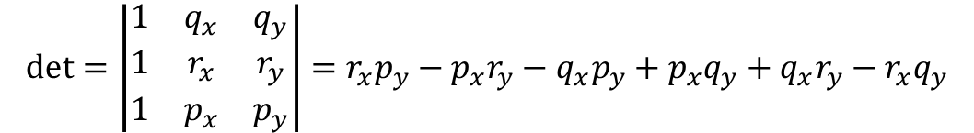
Geometric orientation test
det = 0
det > 0
p
180 ° < α < 360°
Purpose of example
illustrate tuples
list comprehension
matplotlib.pyplot
floats are strange
0 ° < α < 180°
r
= (24, 24)
det < 0
y
q
= (12, 12)
(0.5, 0.5)
(0.5+ε, 0.5+ε)
x
$$\text{det}=\left|\begin{matrix}1 & q_{x} & q_{y} \\ 1 & r_{x} & r_{y} \\ 1 & p_{x} & p_{y}\end{matrix}\right|=r_{x}p_{y}−p_{x}r_{y}−q_{x}p_{y}+p_{x}q_{y}+q_{x}r_{y}−r_{x}q_{y}$$
Kettner, Mehlhorn, Pion, Schirra, Yap: Classroom Examples of Robustness Problems in Geometric Computations
6 ! = 720 different orders to add

Slide 25
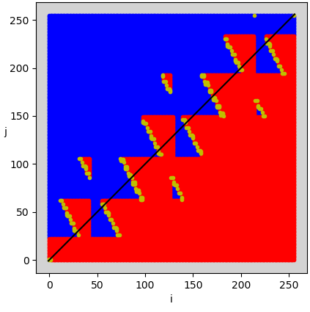
sign-plot.py
import matplotlib.pyplot as plt N = 256 delta = 1 / 2**54 q = (12, 12) r = (24, 24) P = [] # points (i, j, det) for i in range(N): for j in range(N): p = (1/2 + i * delta, 1/2 + j * delta) det = (q[0]*r[1] + r[0]*p[1] + p[0]*q[1] - r[0]*q[1] - p[0]*r[1] - q[0]*p[1]) P.append((i, j, det)) pos = [(i, j) for i, j, det in P if det > 0] neg = [(i, j) for i, j, det in P if det < 0] zero = [(i, j) for i, j, det in P if det == 0] plt.subplot(facecolor='lightgrey', aspect='equal') plt.xlabel('i') plt.ylabel('j', rotation=0) for points, color in [(pos, "b"), (neg, "r"), (zero, "y")]: X = [x for x, y in points] Y = [y for x, y in points] plt.plot(X, Y, color + ".") plt.plot([-1, N], [-1, N], "k-") plt.show()
(0.5000000000000142, 0.5000000000000142)
(0.5, 0.5)
det > 0
det = 0
det < 0

Slide 26
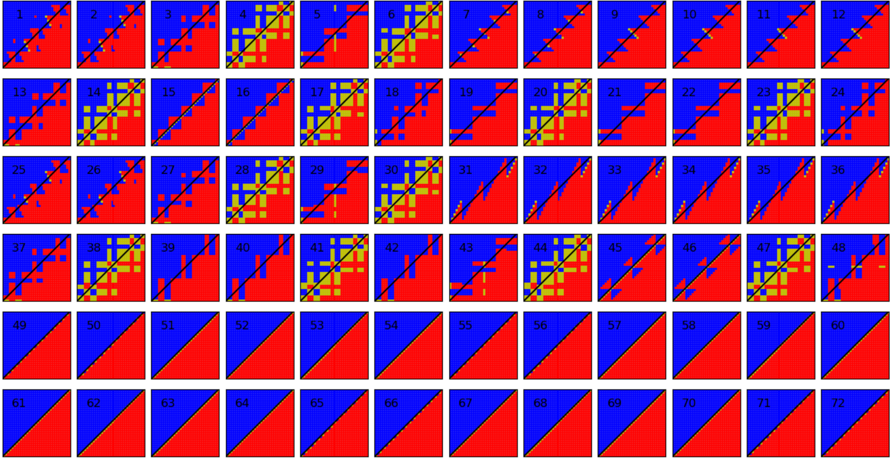

Slide 27
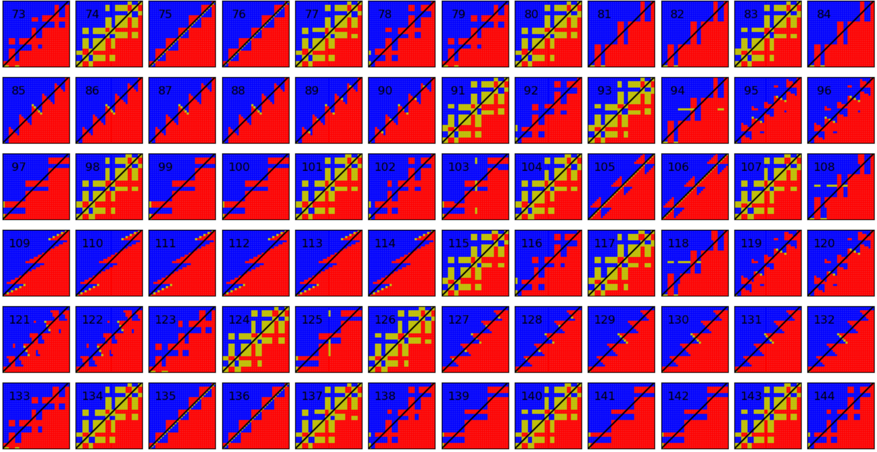

Slide 28
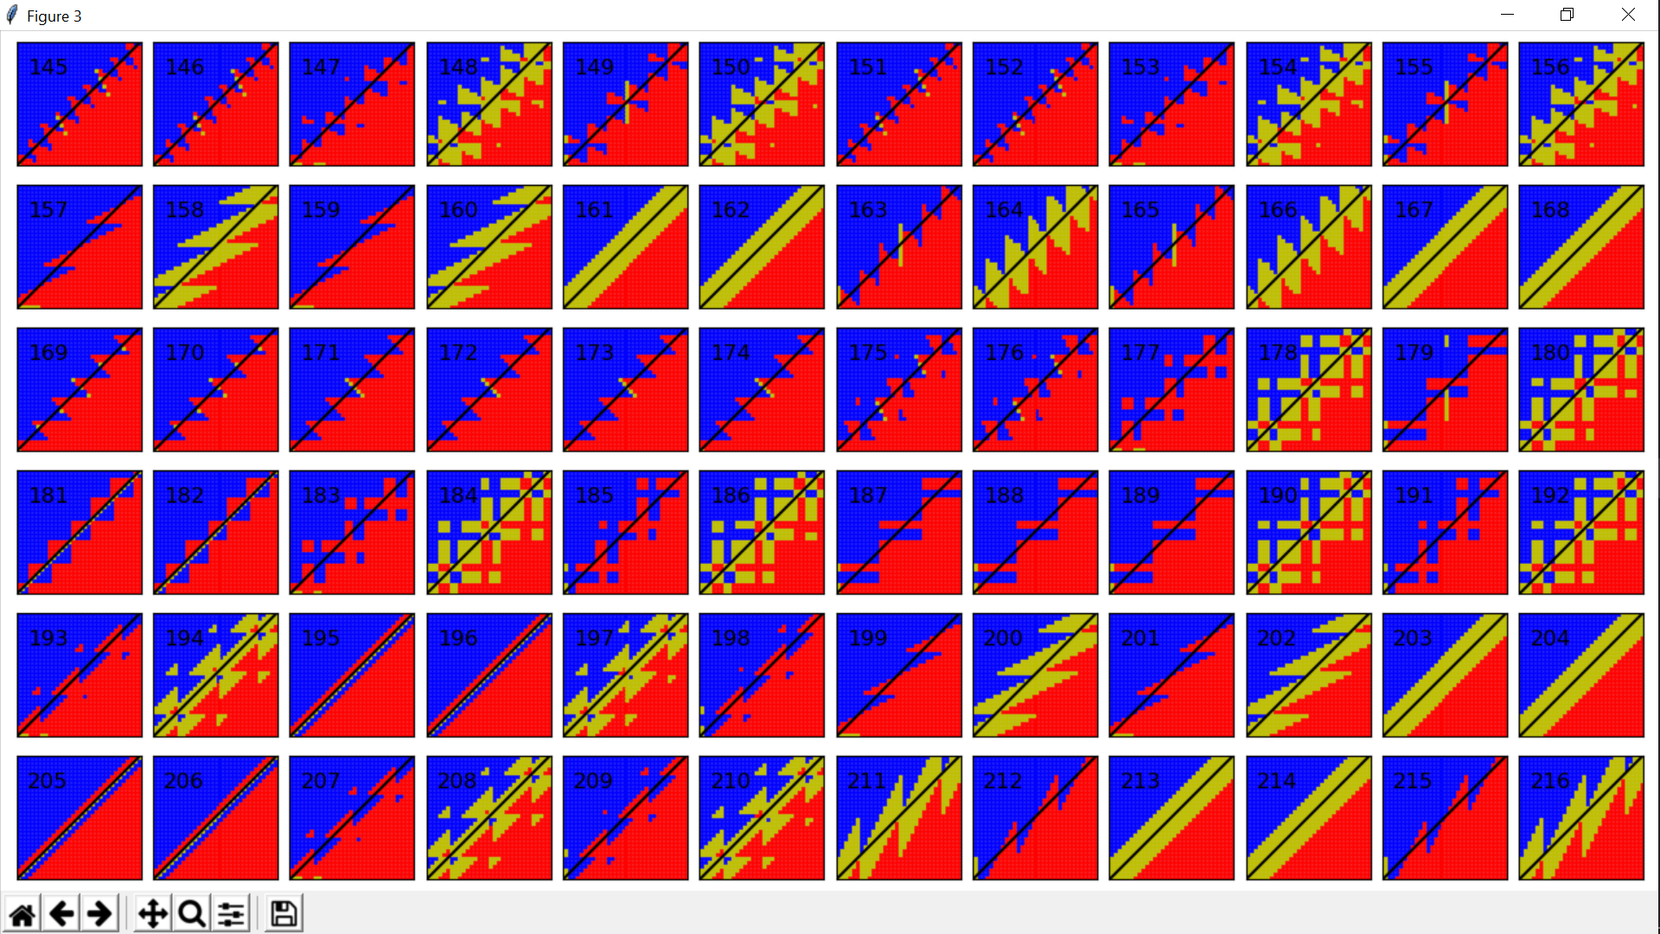

Slide 29
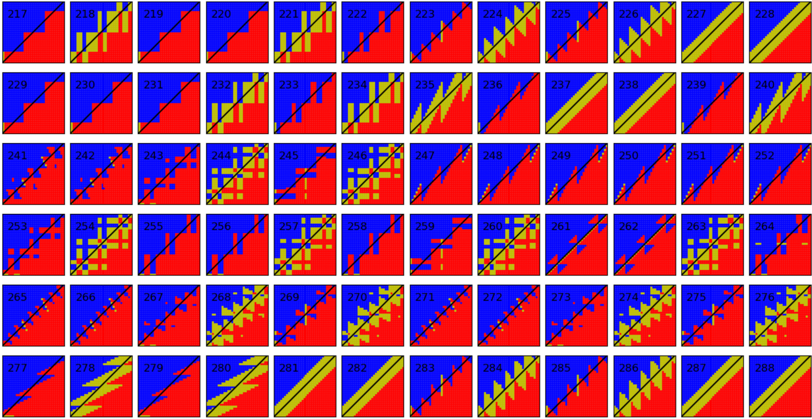

Slide 30
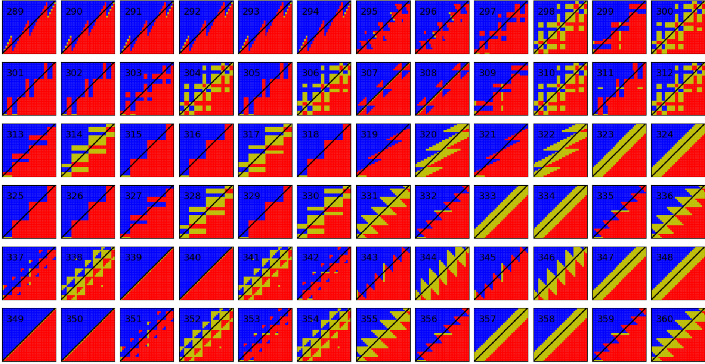

Slide 31
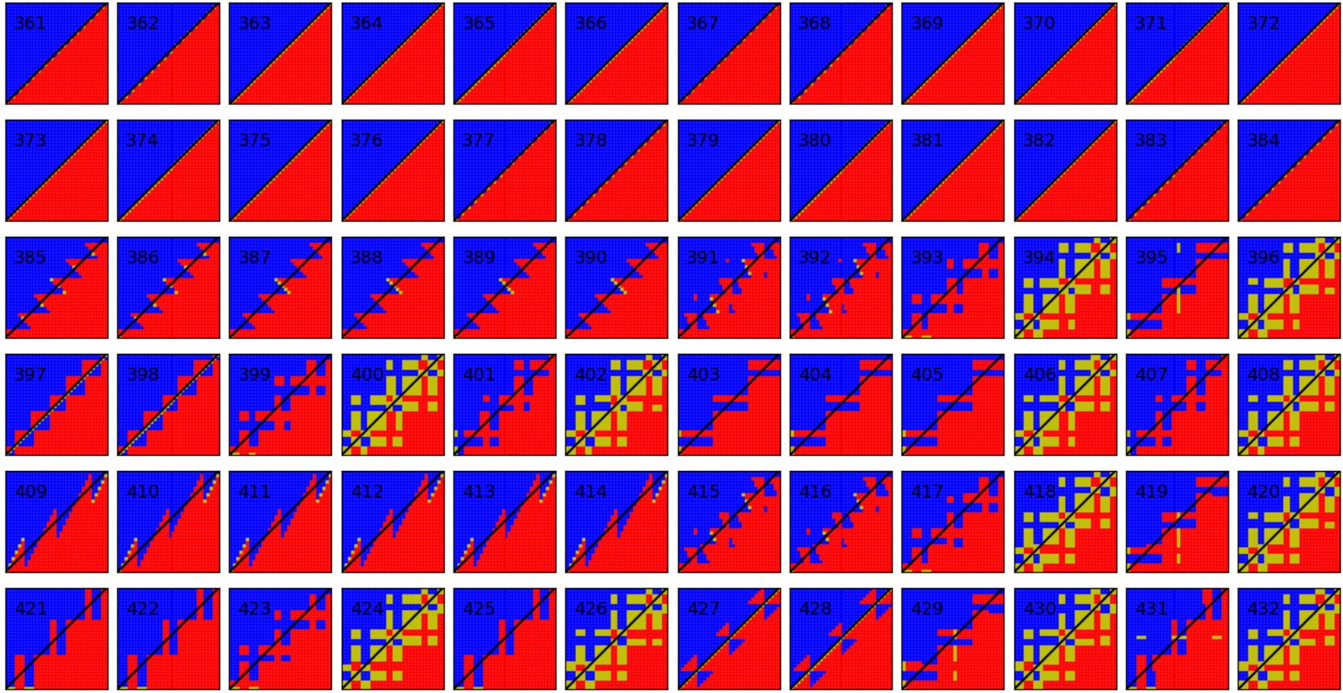

Slide 32
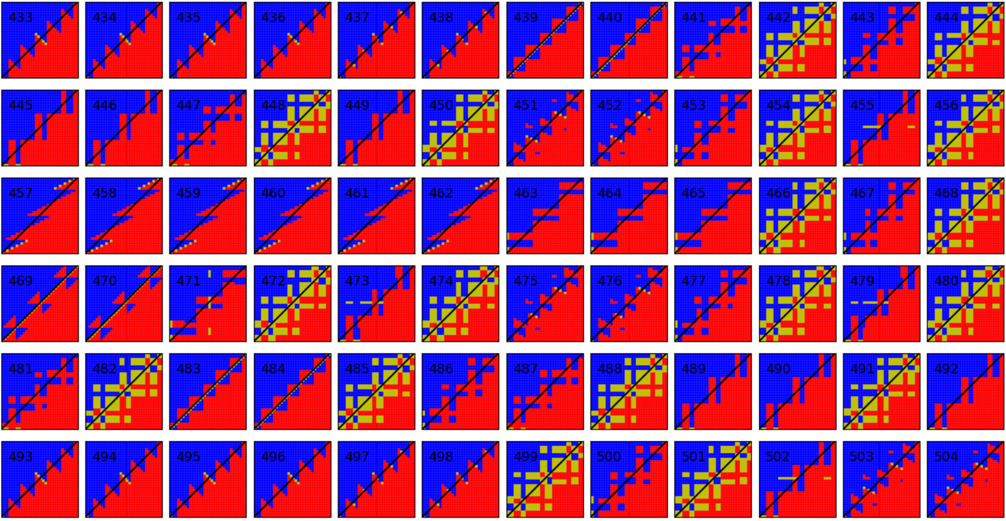

Slide 33
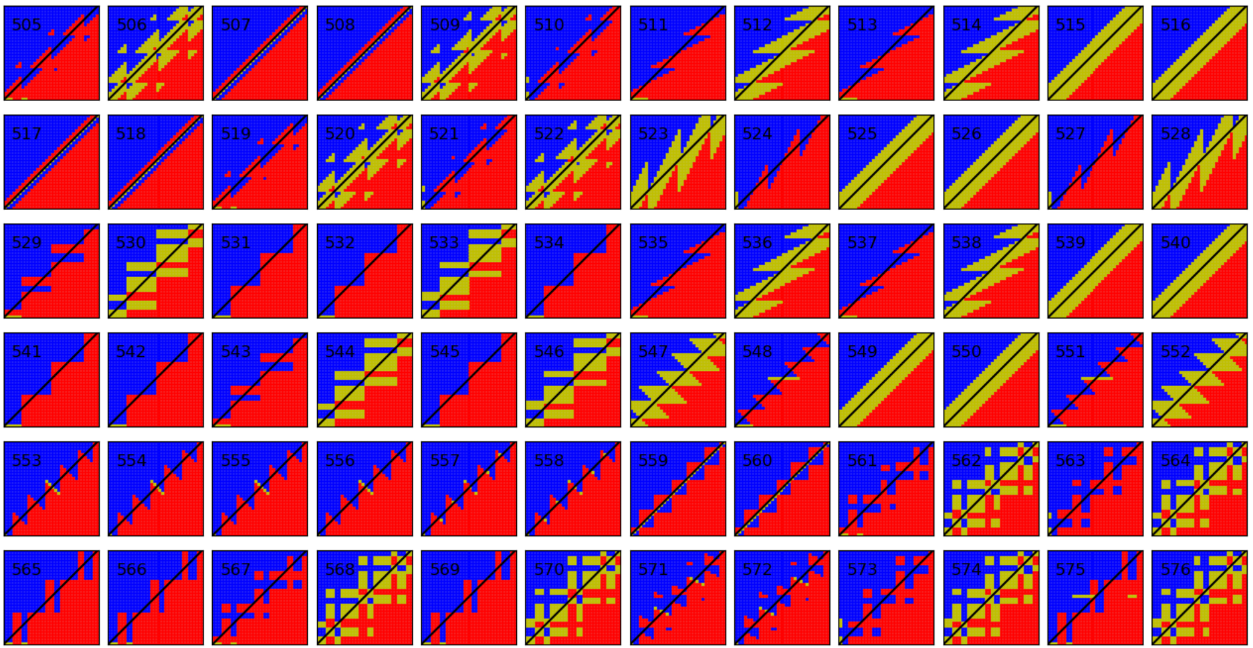

Slide 34
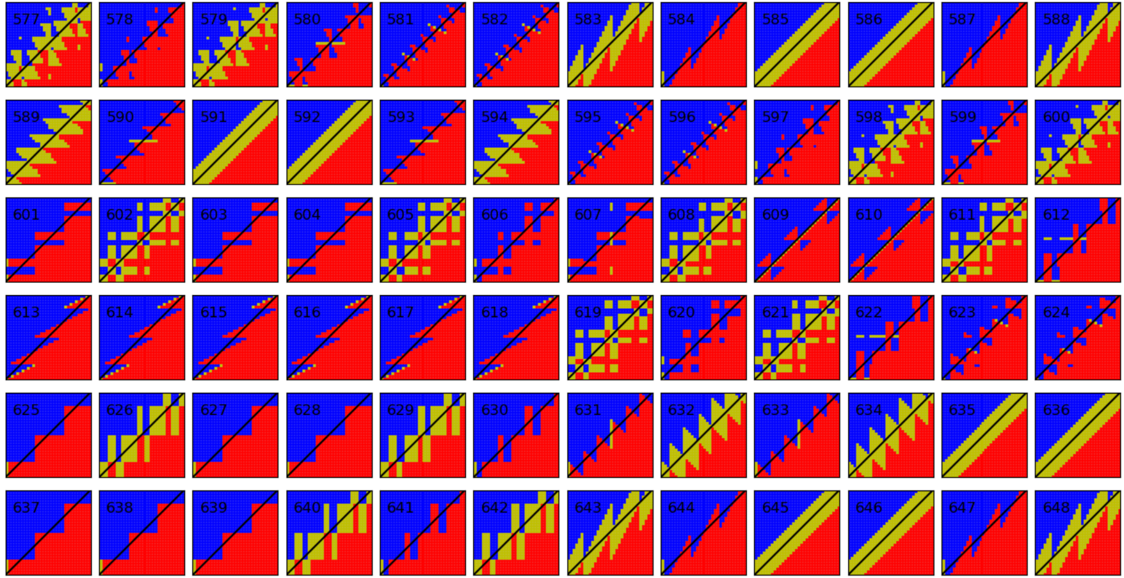

Slide 35
